Slide 1
City of Ottawa
STATE OF THE CITY
Thursday, October 4, 2012

Slide 2
THE CHAMBER
OTTAWA AREA CHAMBER
OF COMMERCE & INDUSTRY

Slide 3


Slide 4
OTTAWA BUSINESS GROWTH
& JOB RETENTION

Slide 5

U.S. Silica

Slide 6

B&B Electronics

Slide 7
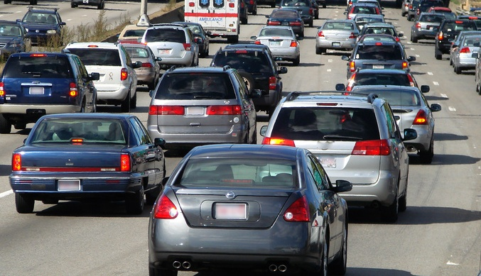
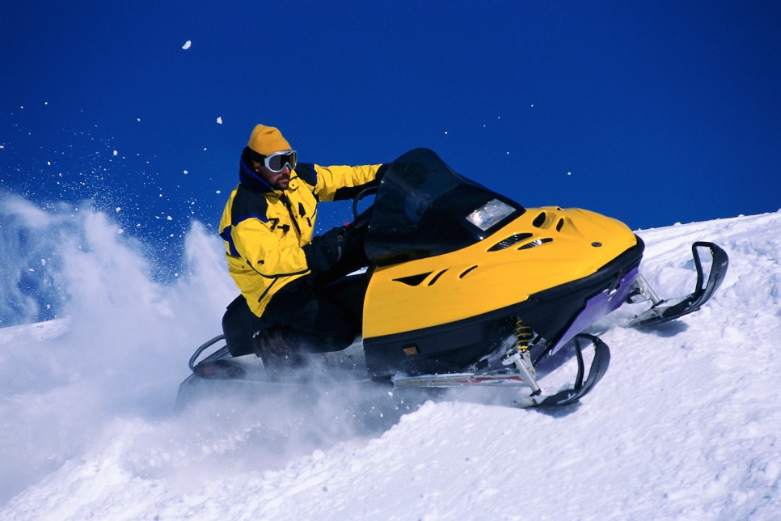
MBL USA CORPORATION

Slide 8
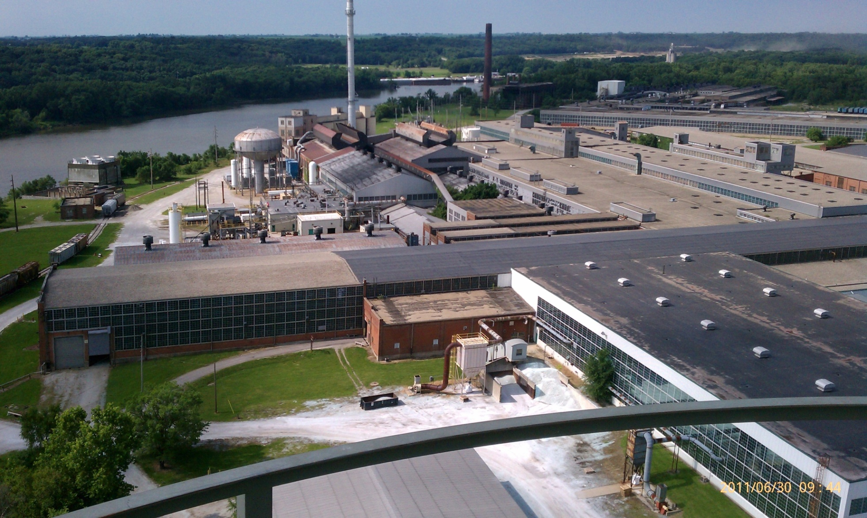
Pilkington

Slide 9
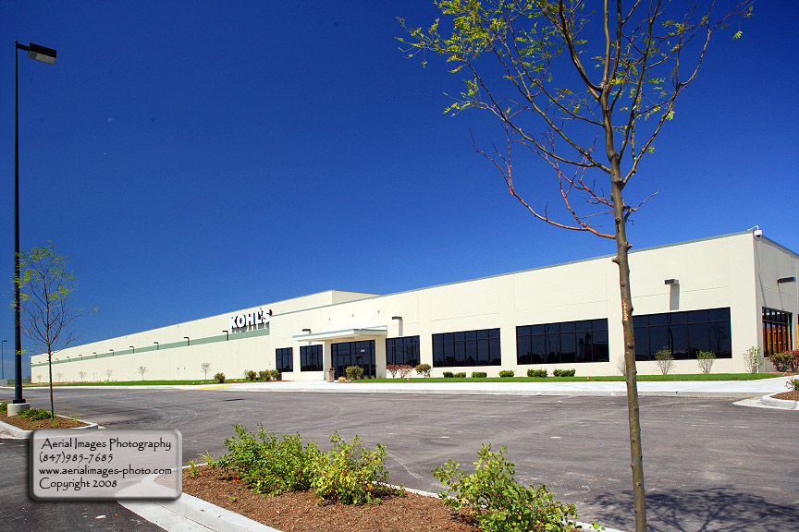
Kohl’s Distribution

Slide 10
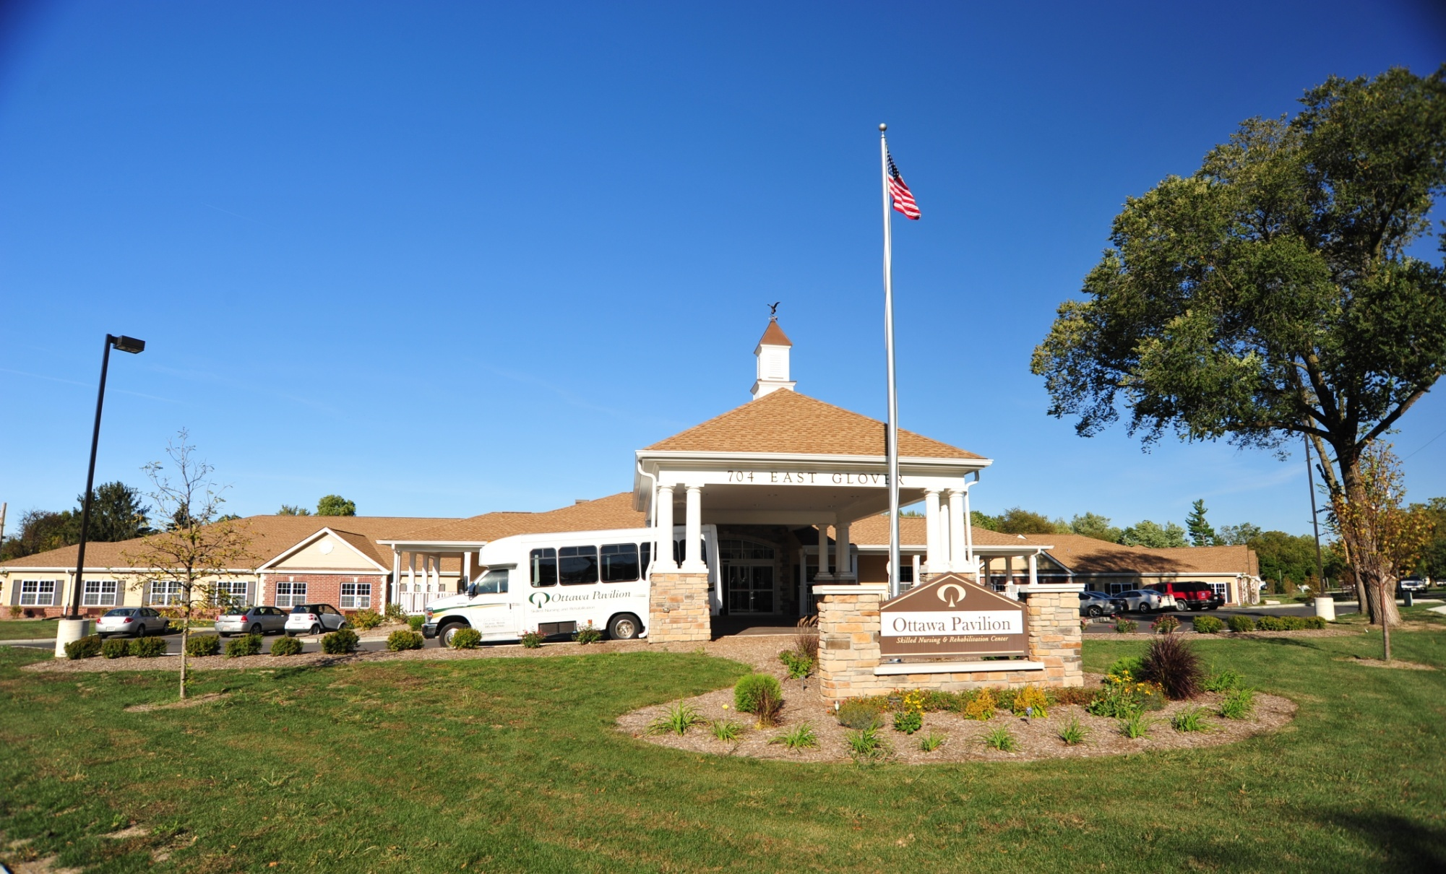
Ottawa Pavilion

Slide 11
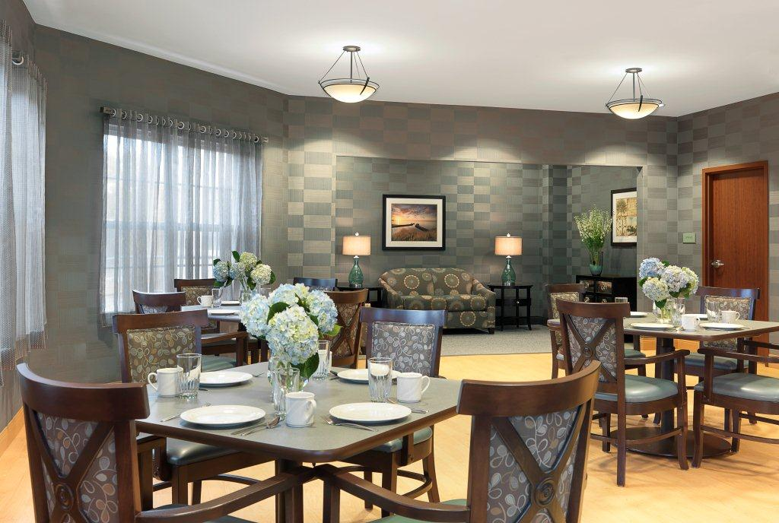
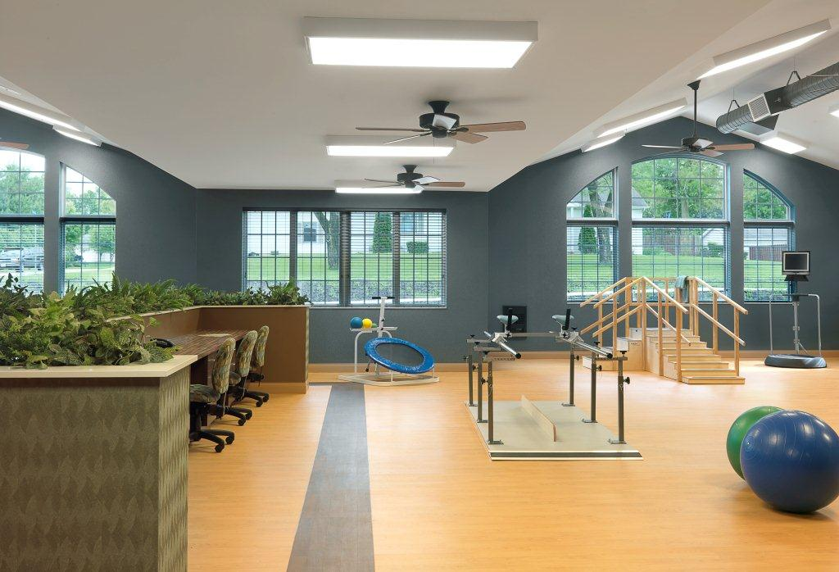
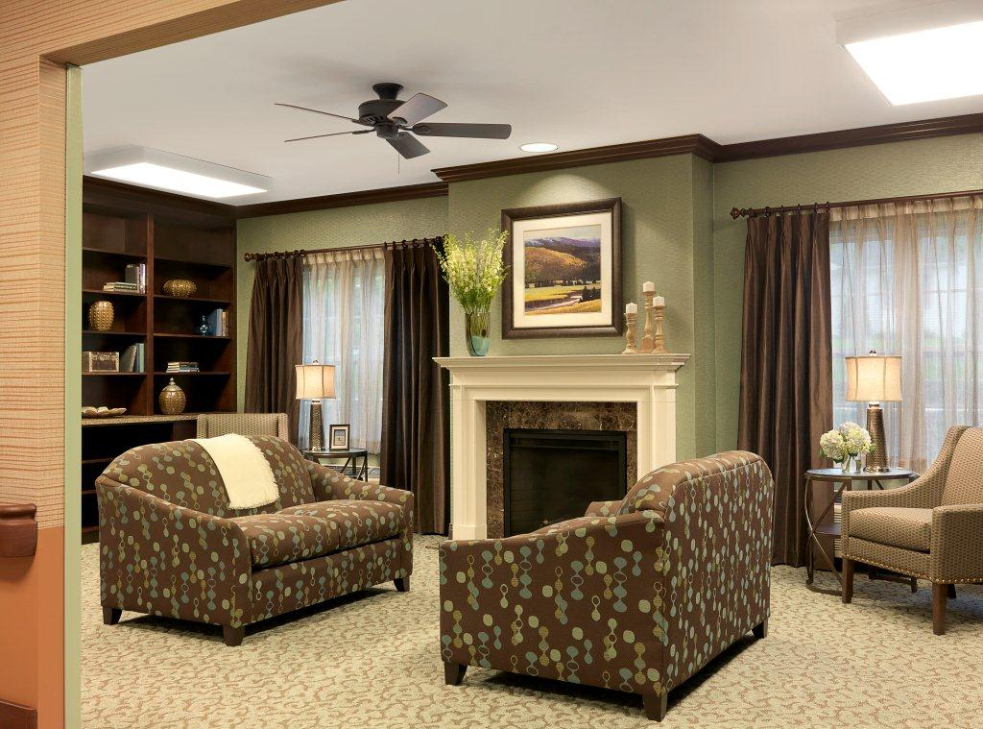
Ottawa Pavilion

Slide 12
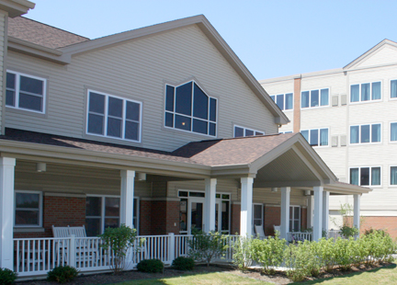
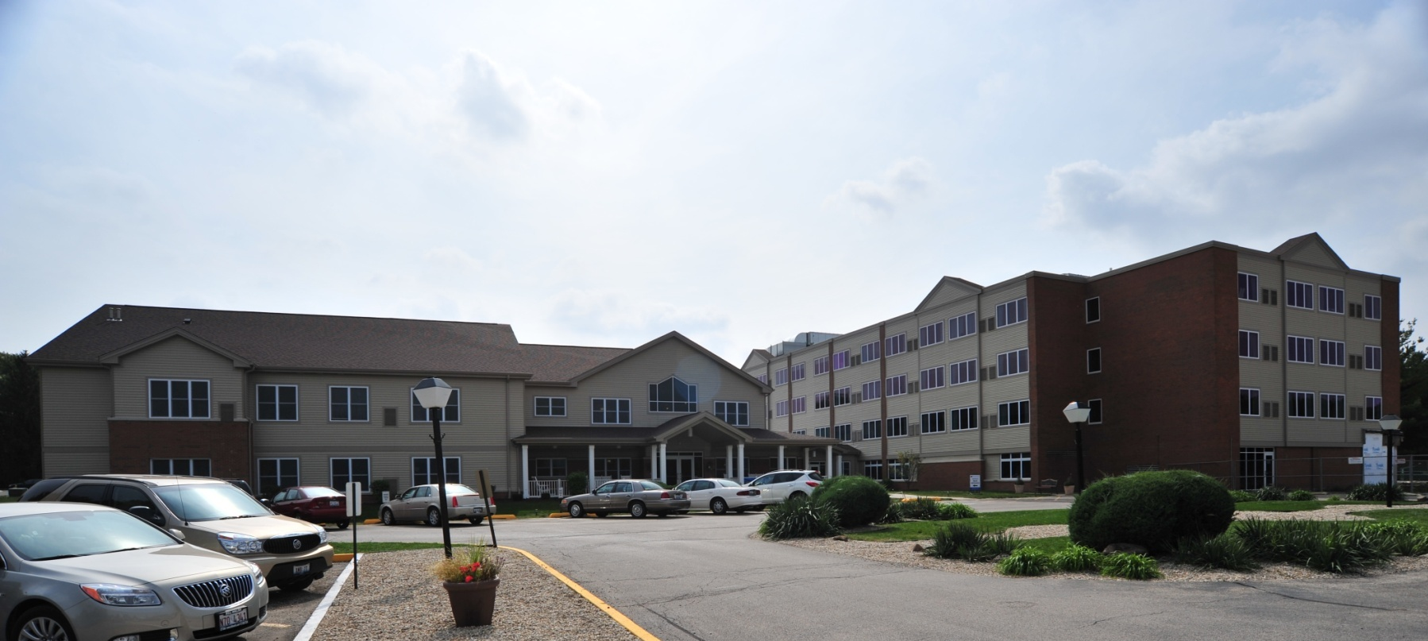
Pleasant View
A Lutheran Life Community

Slide 13
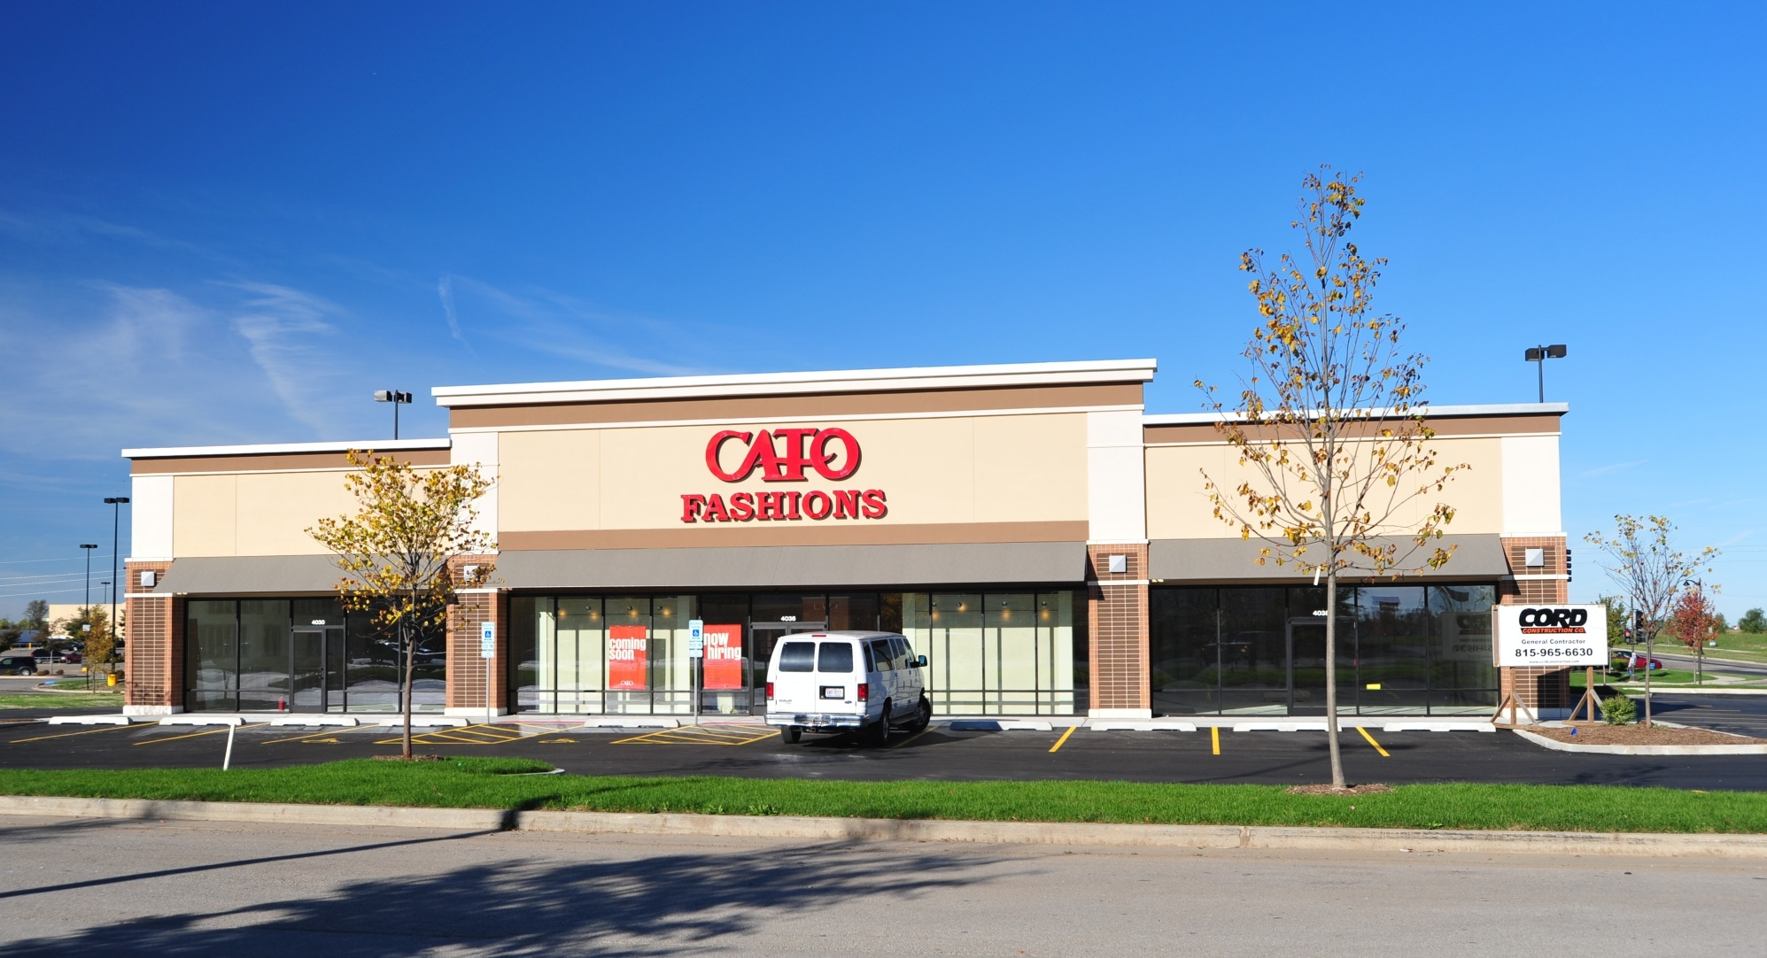
Radio Shack - Cato Fashions

Slide 14
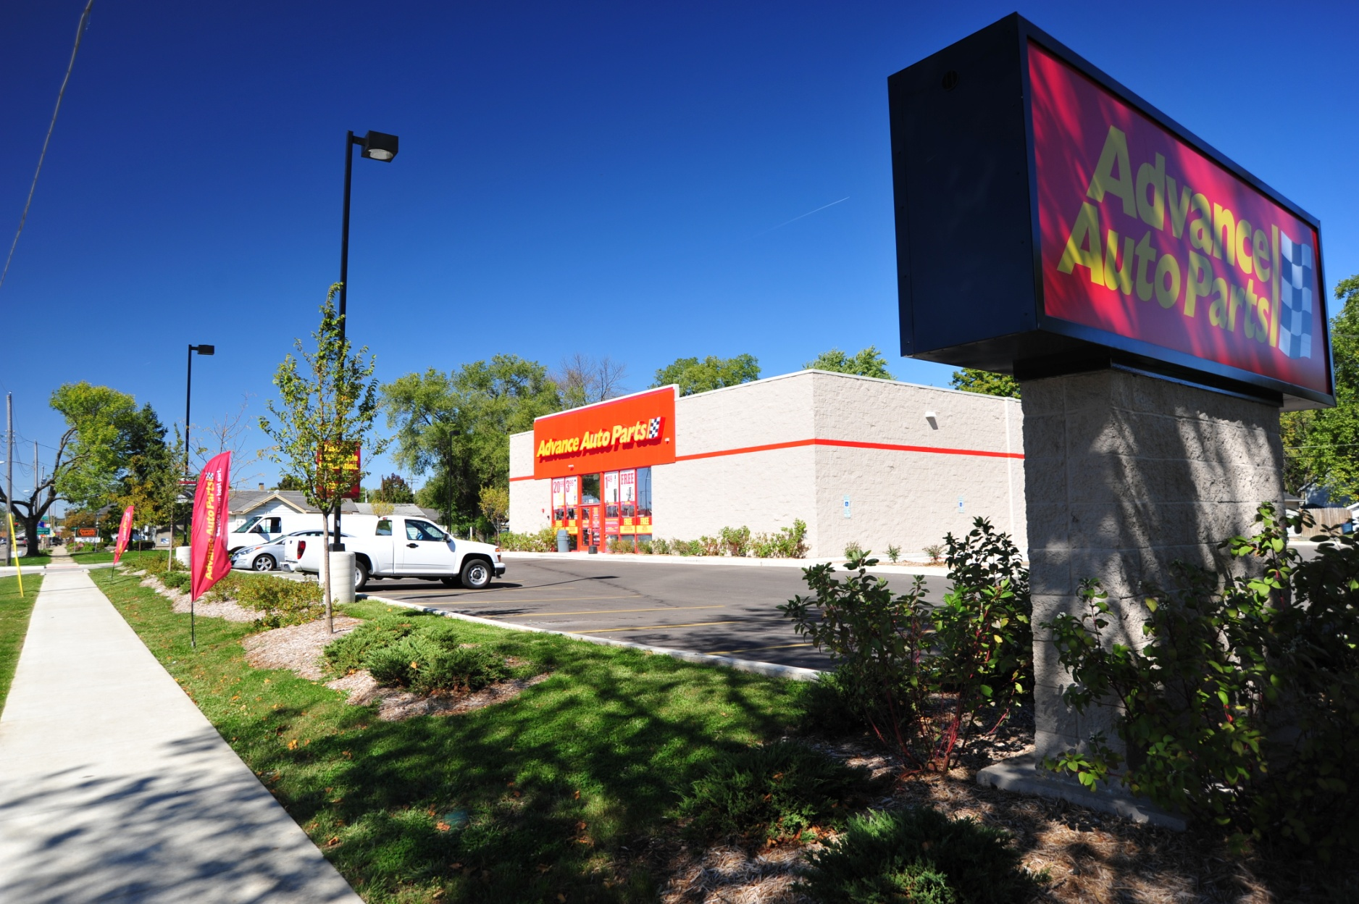
Advance Auto Parts

Slide 15
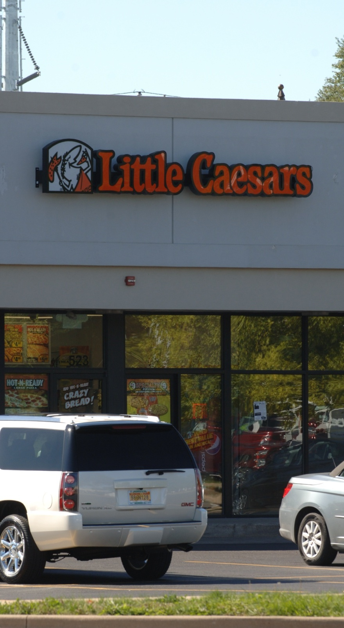
Little
Caesars

Slide 16
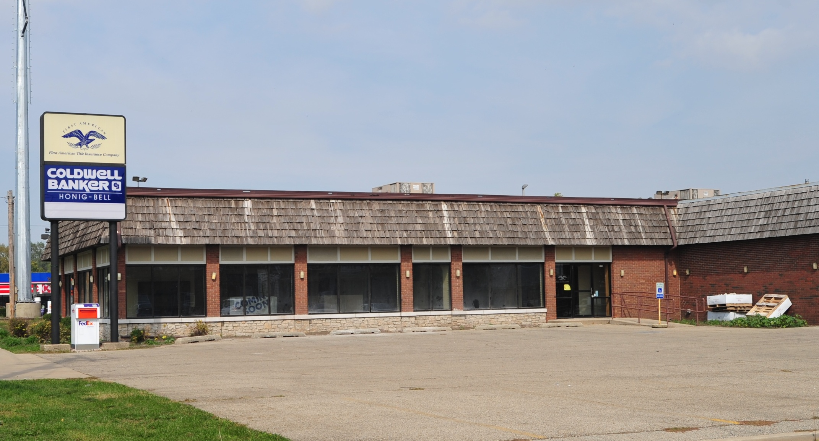
Coldwell Banker

Slide 17
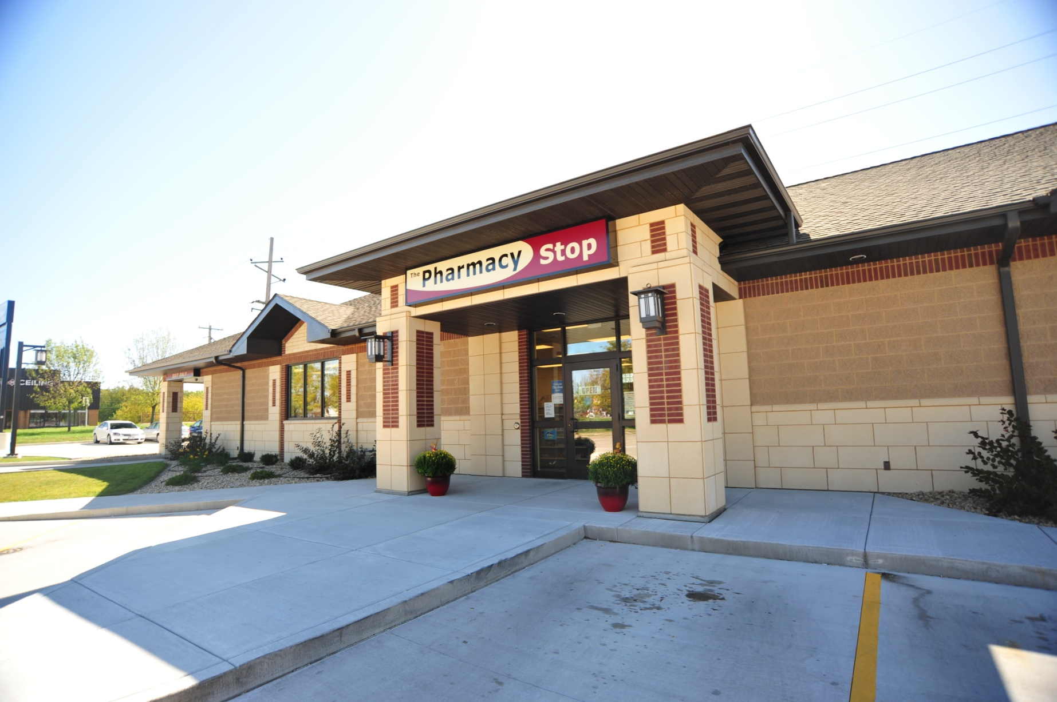
The Pharmacy Stop

Slide 18
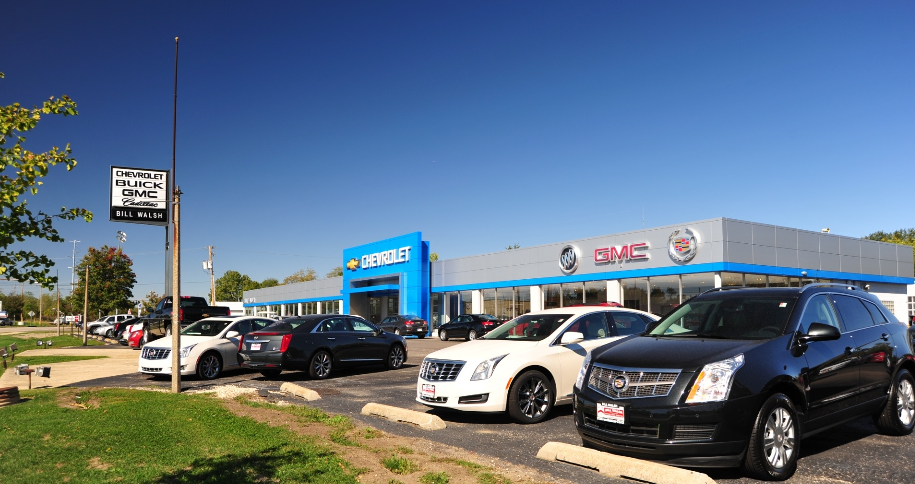
Bill Walsh Chevrolet Store

Slide 19
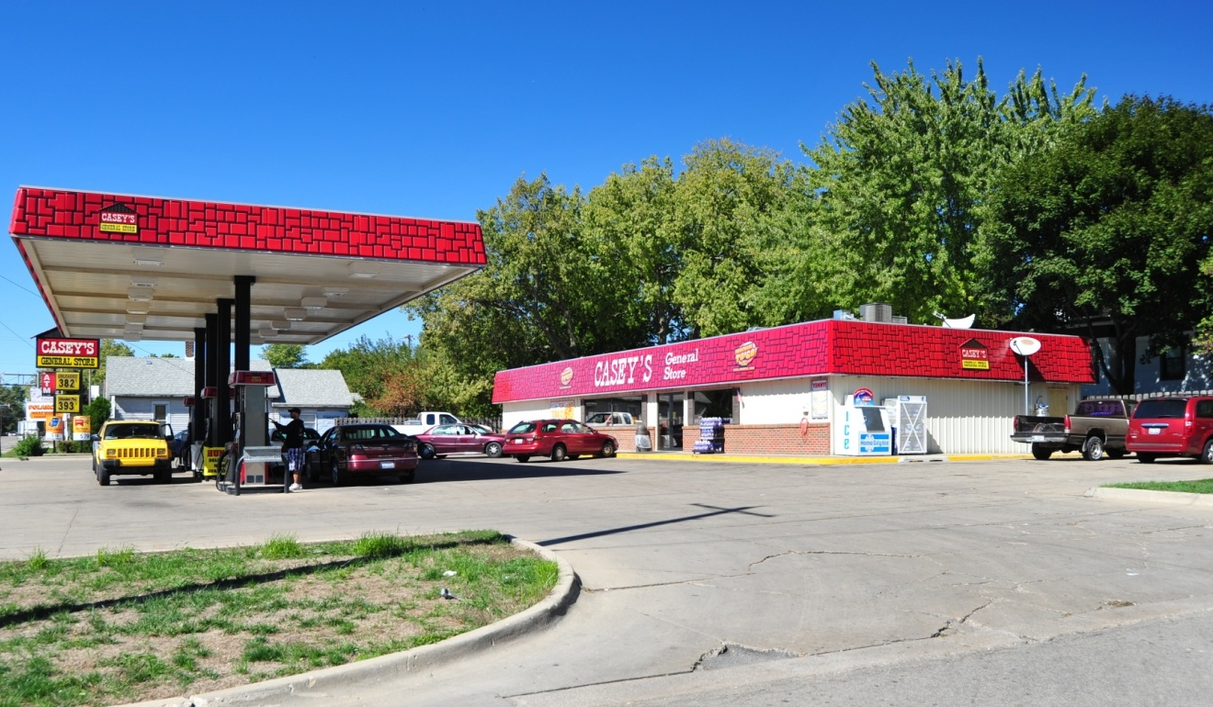
Casey’s Gas Station

Slide 20
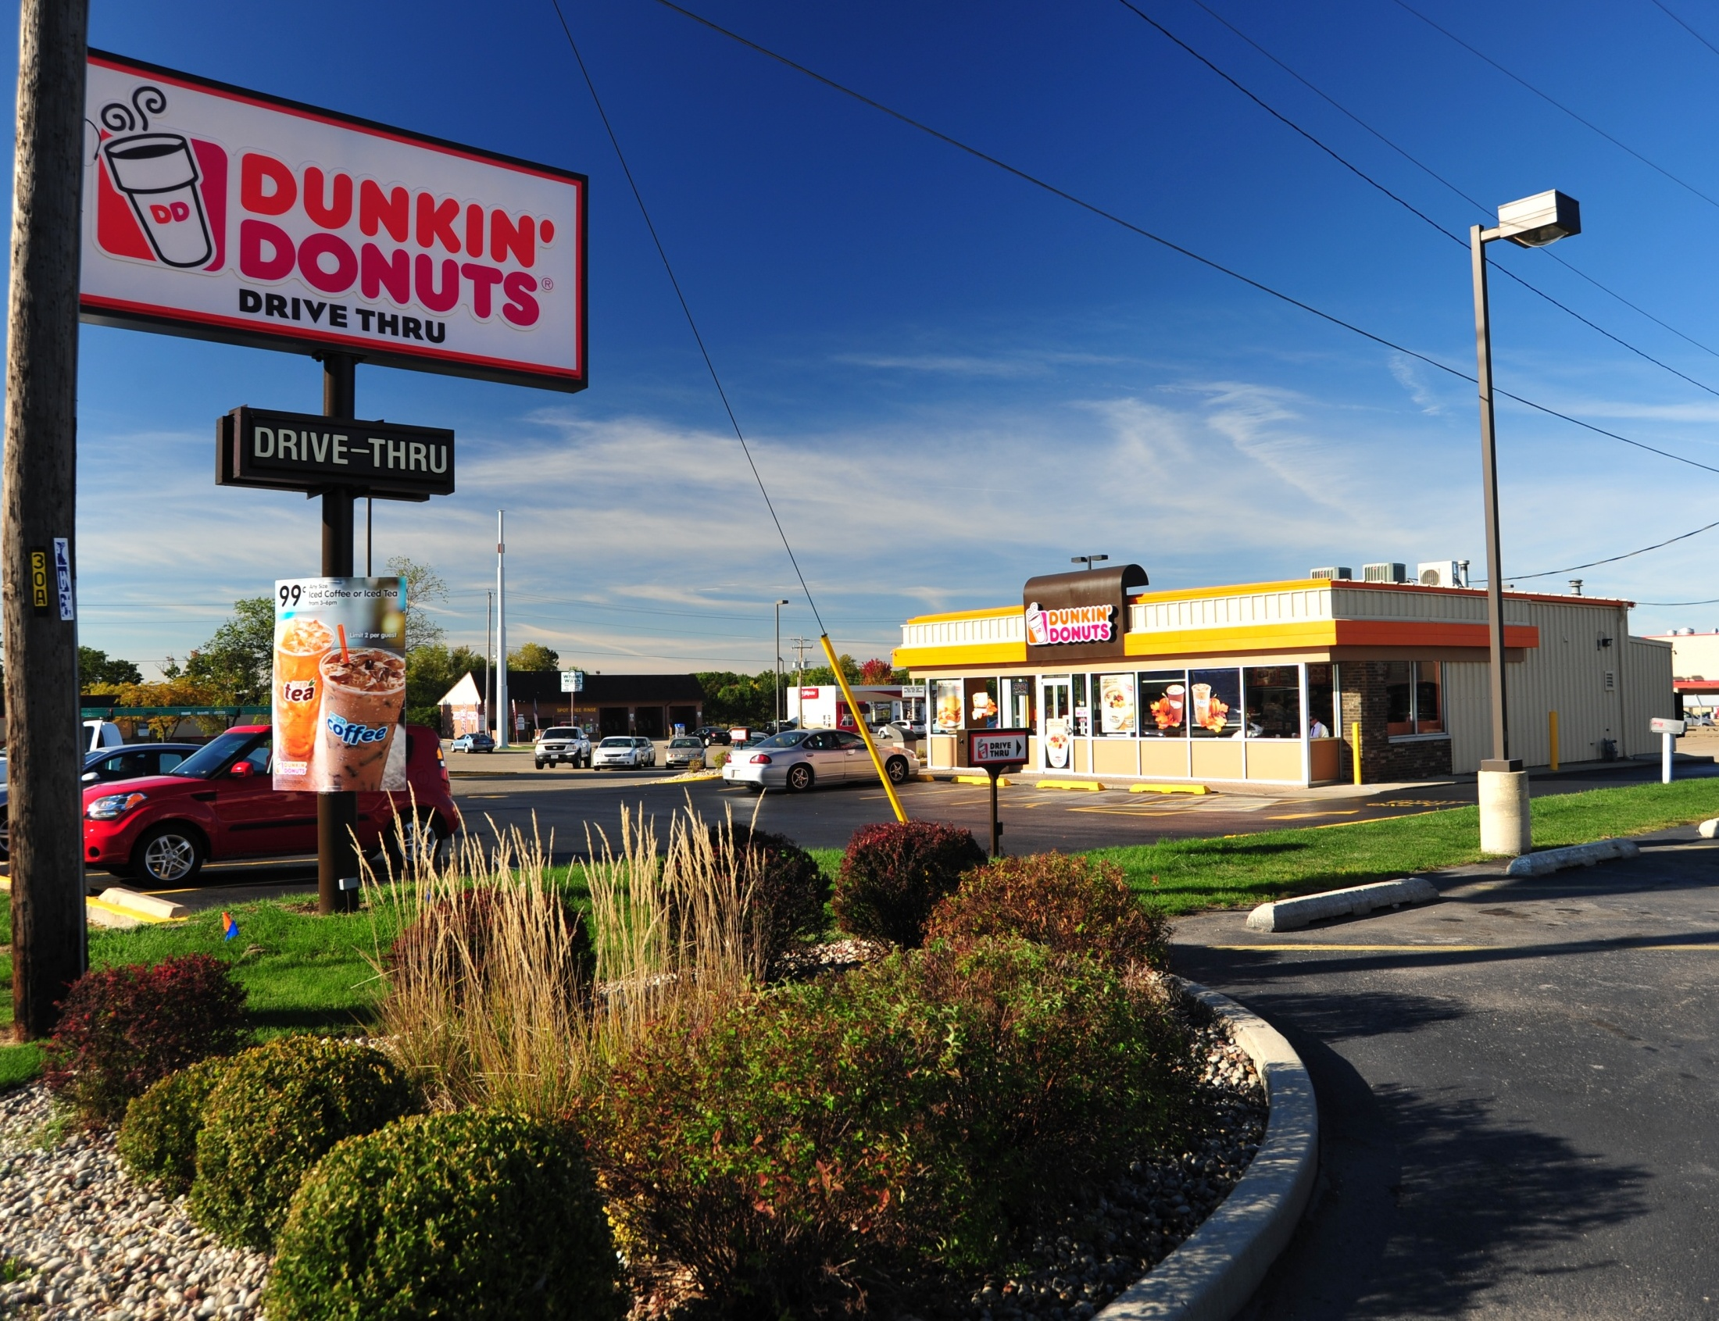

Slide 21
ONGOING ECONOMIC Development efforts

Slide 23
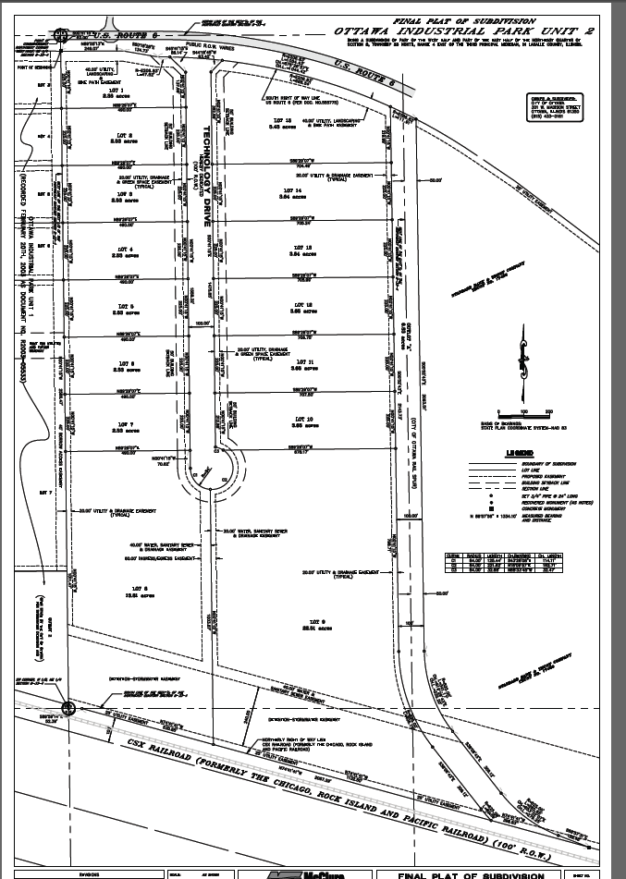
Ottawa Industrial
Park
Unit 2

Slide 24
INVESTMENT IN PRIVATE AND PUBLIC INFRASTRUCTURE

Slide 25
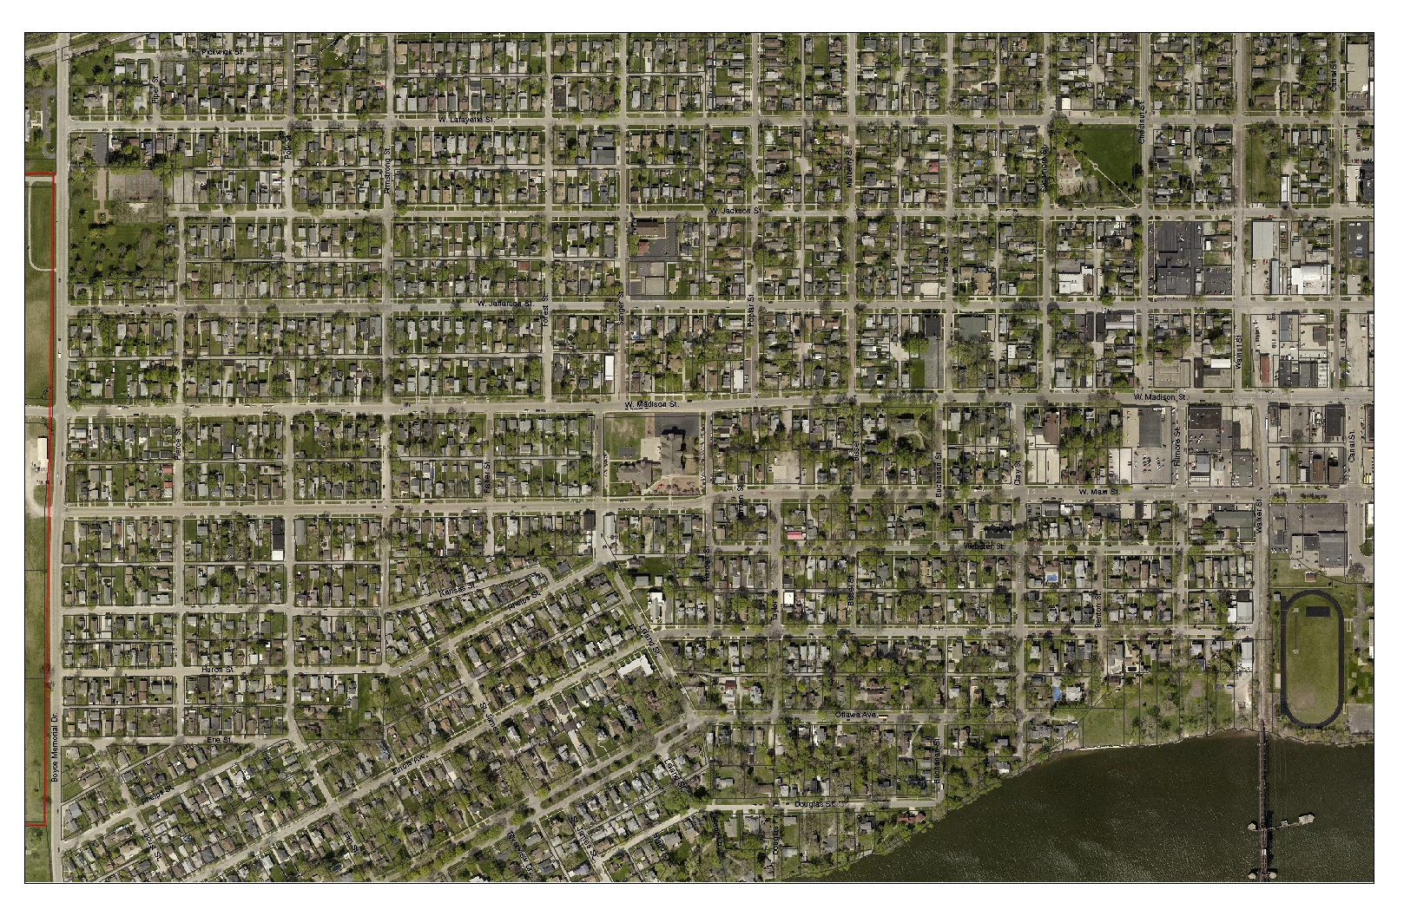
Nicor Gas Main Replacement

Slide 26
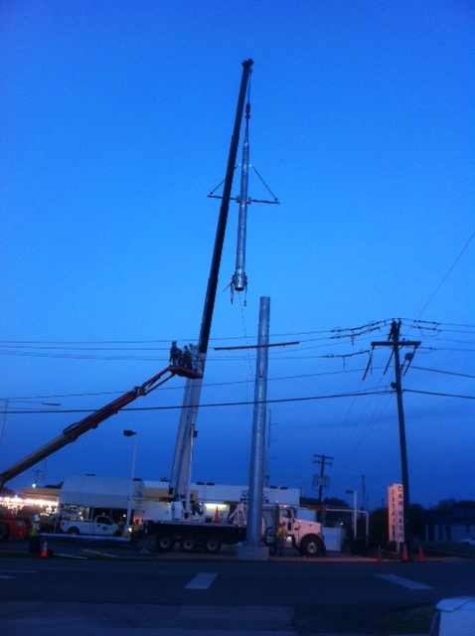
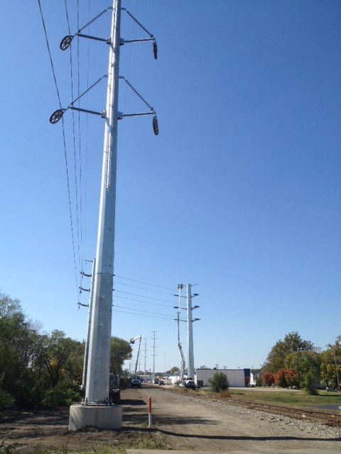
Ameren

Slide 27
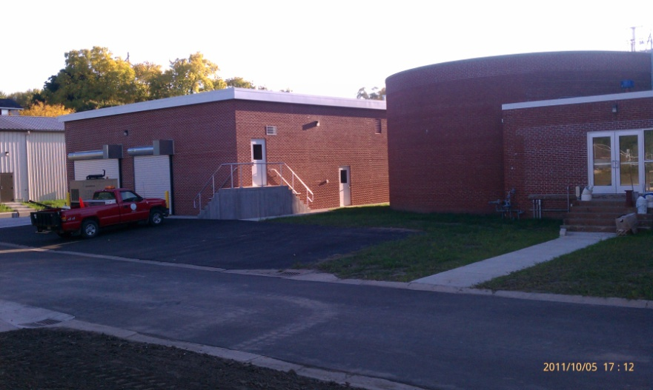
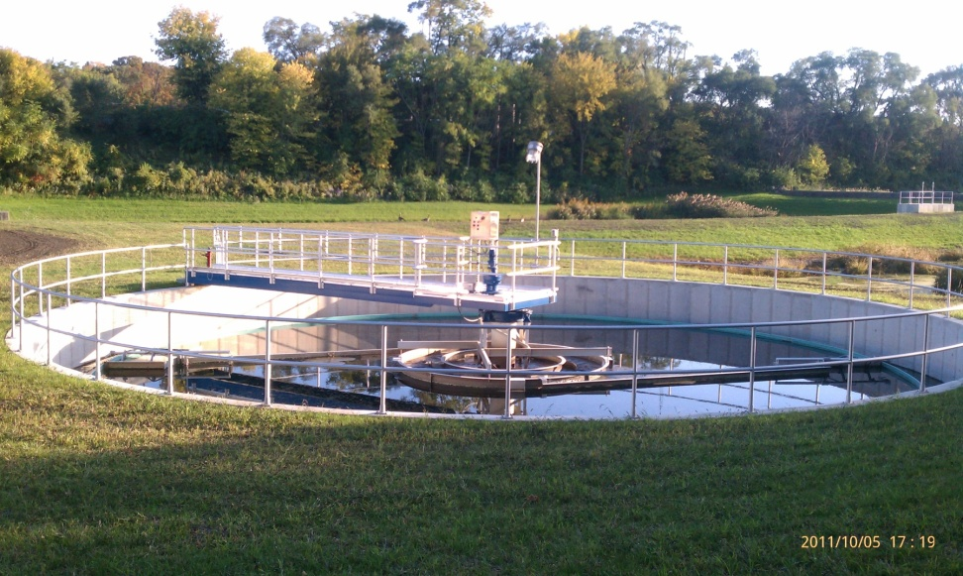
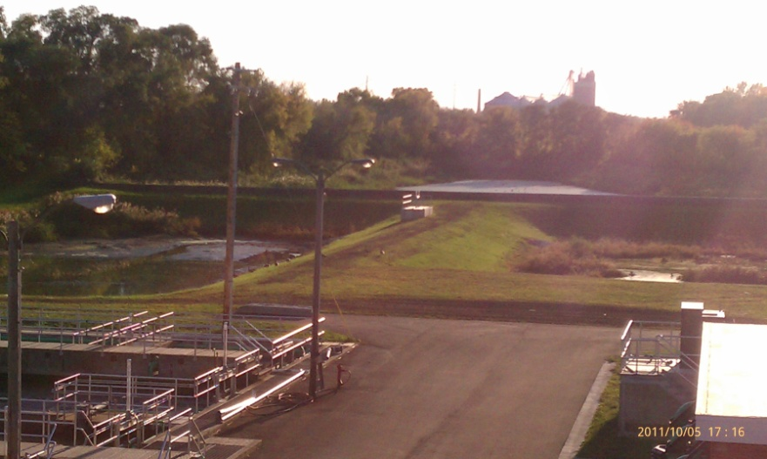
Wastewater Treatment Plant

Slide 28
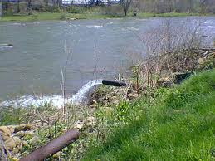
Combined Sewer Overflows

Slide 29
ELECTRIC AGGREATION

Slide 30
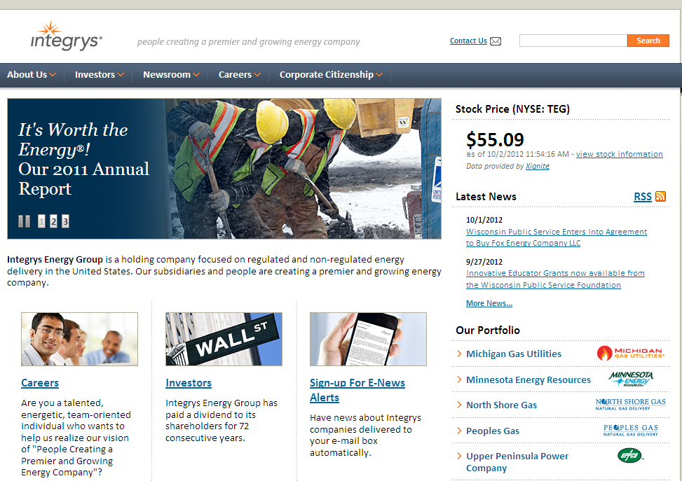
Integrys

Slide 31
Electric Aggregation
SAVED RESIDENTS 28.8%

Slide 32
BROADBAND

Slide 33
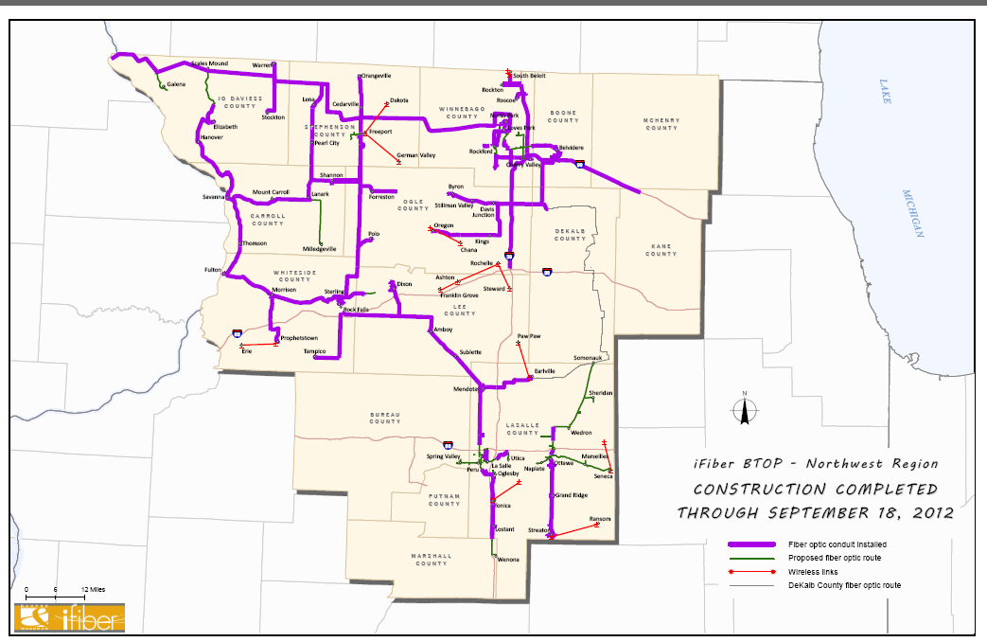
ifiber map

Slide 34
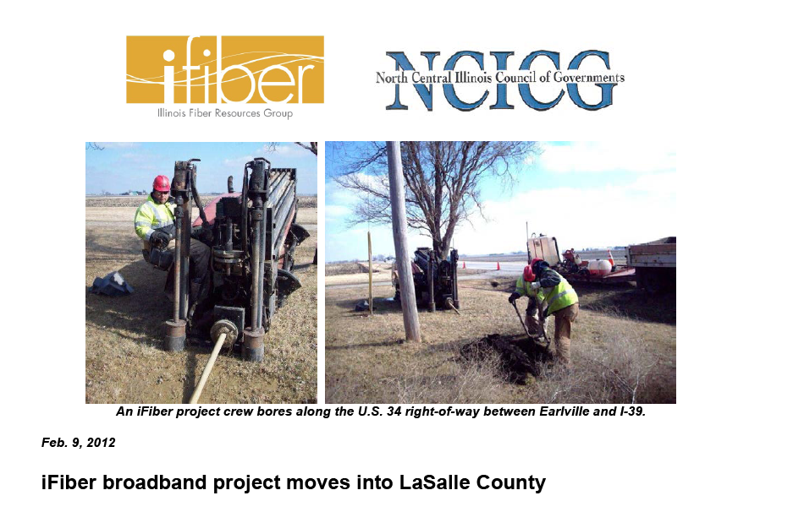
ifiber

Slide 35
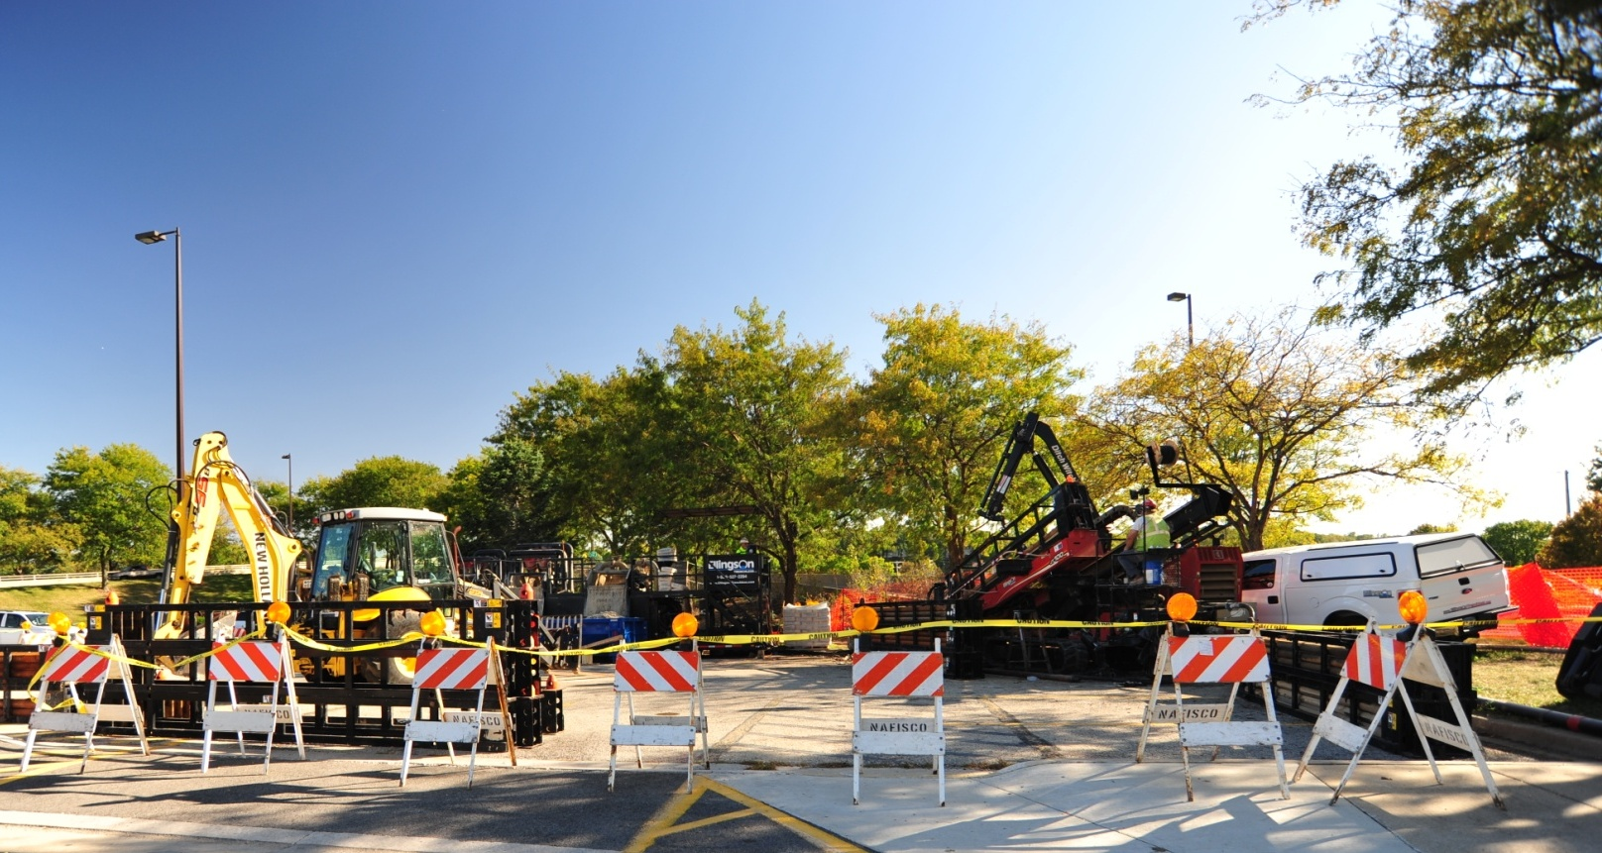
Broadband – boring under the river

Slide 36
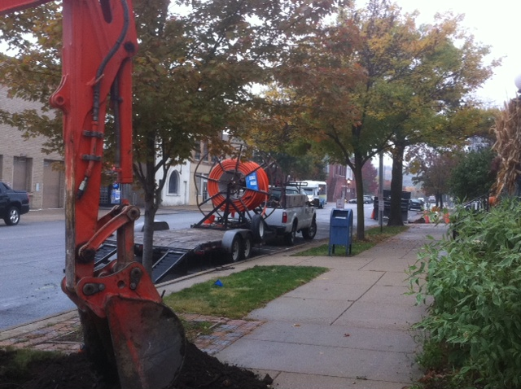
ifiber

Slide 37
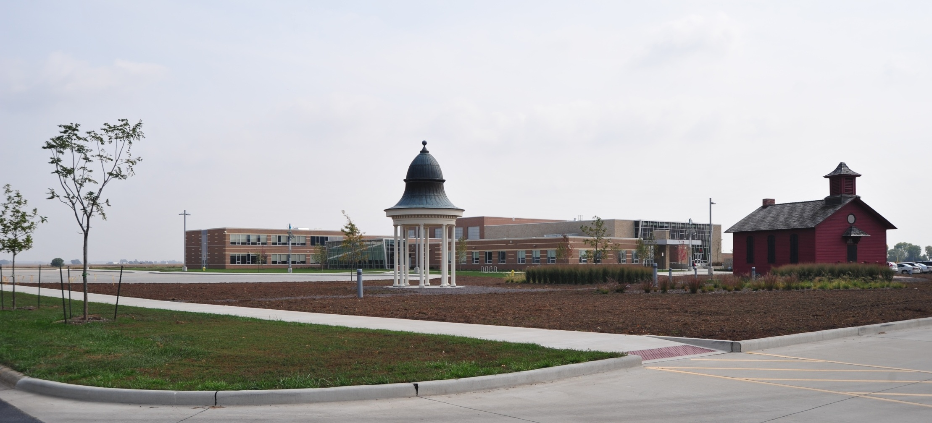
Central Intermediate School

Slide 38
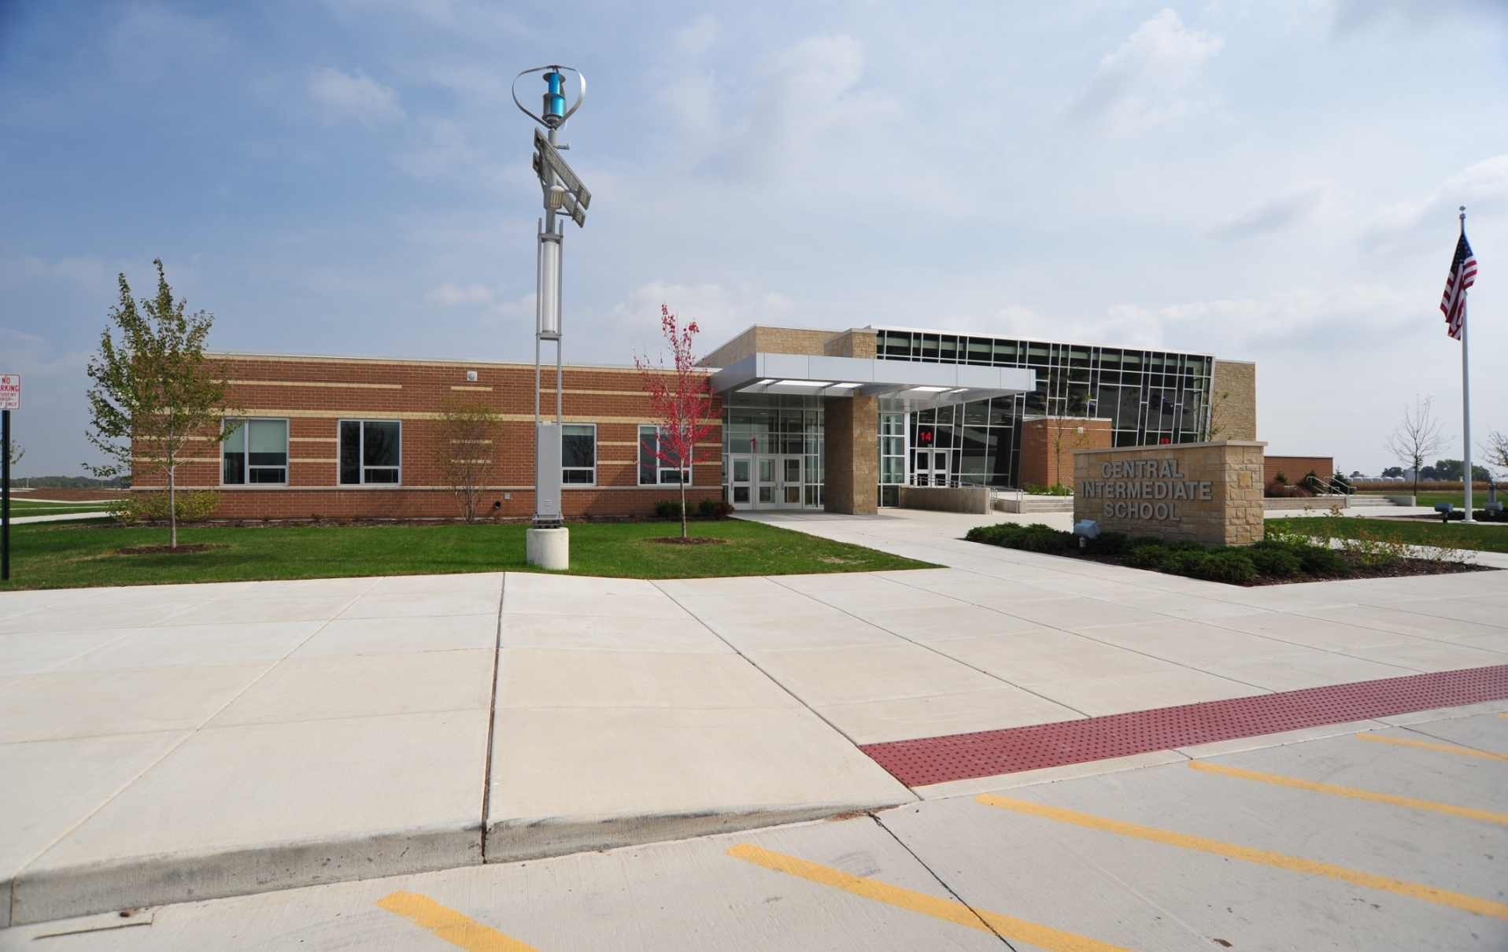
Central Intermediate School

Slide 39
Downtown and the gardening and botanical arts brand

Slide 40
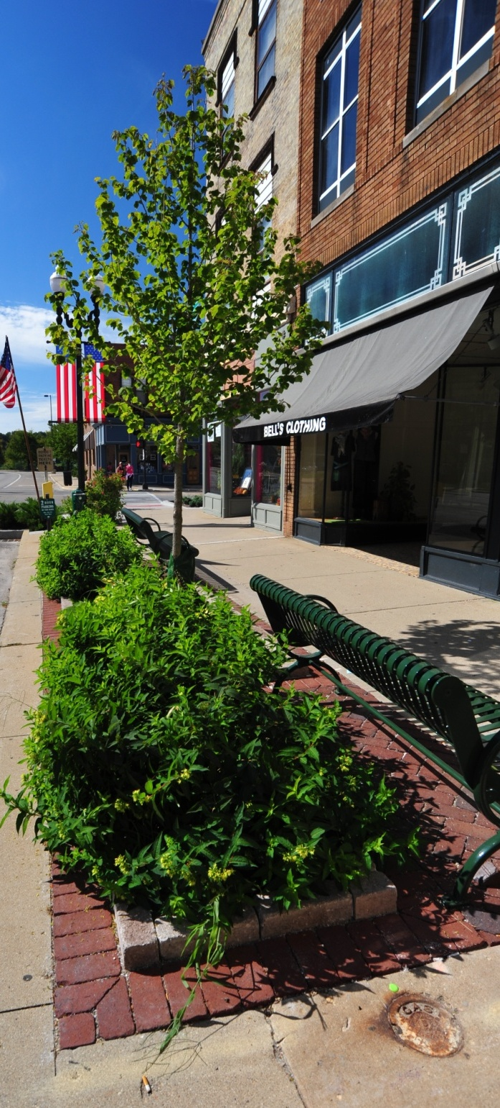
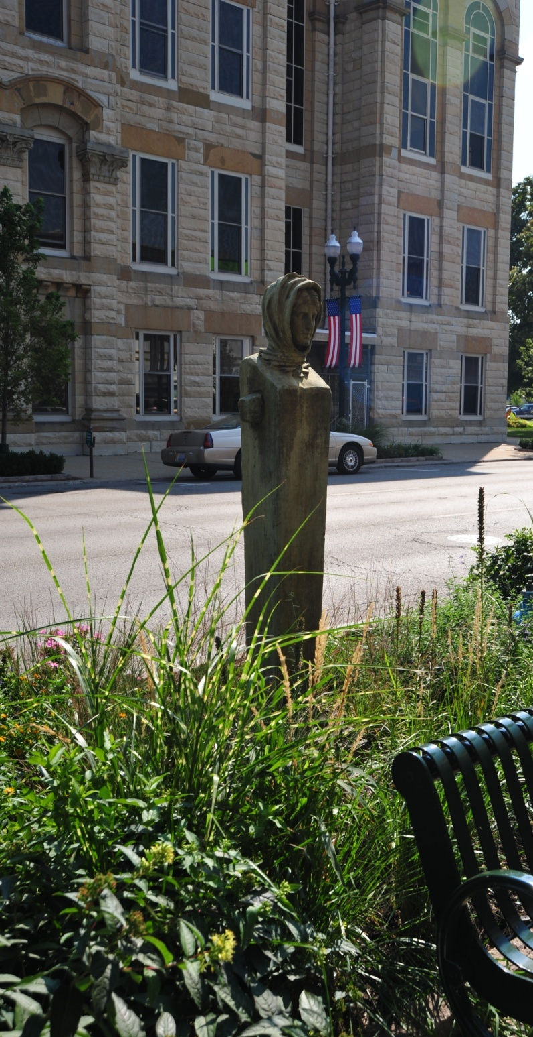
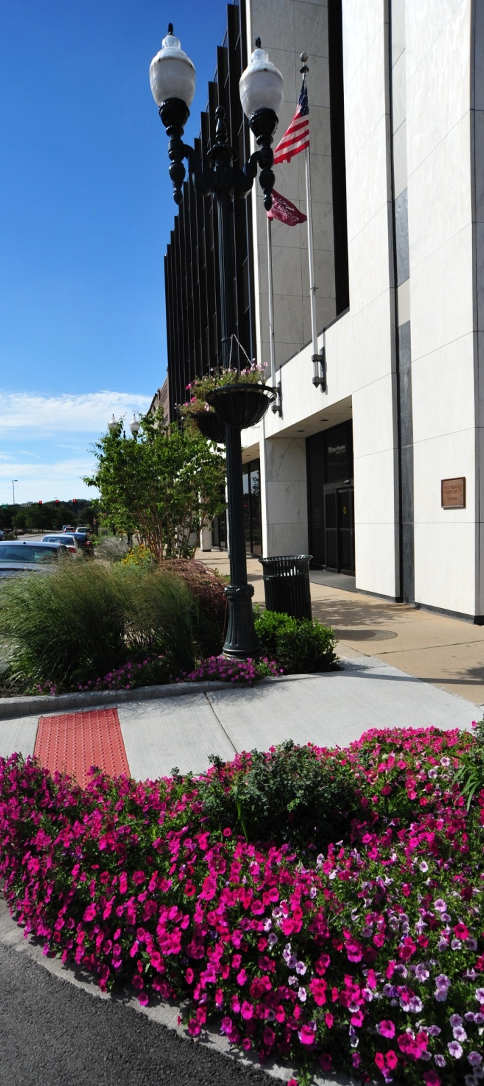

Slide 41
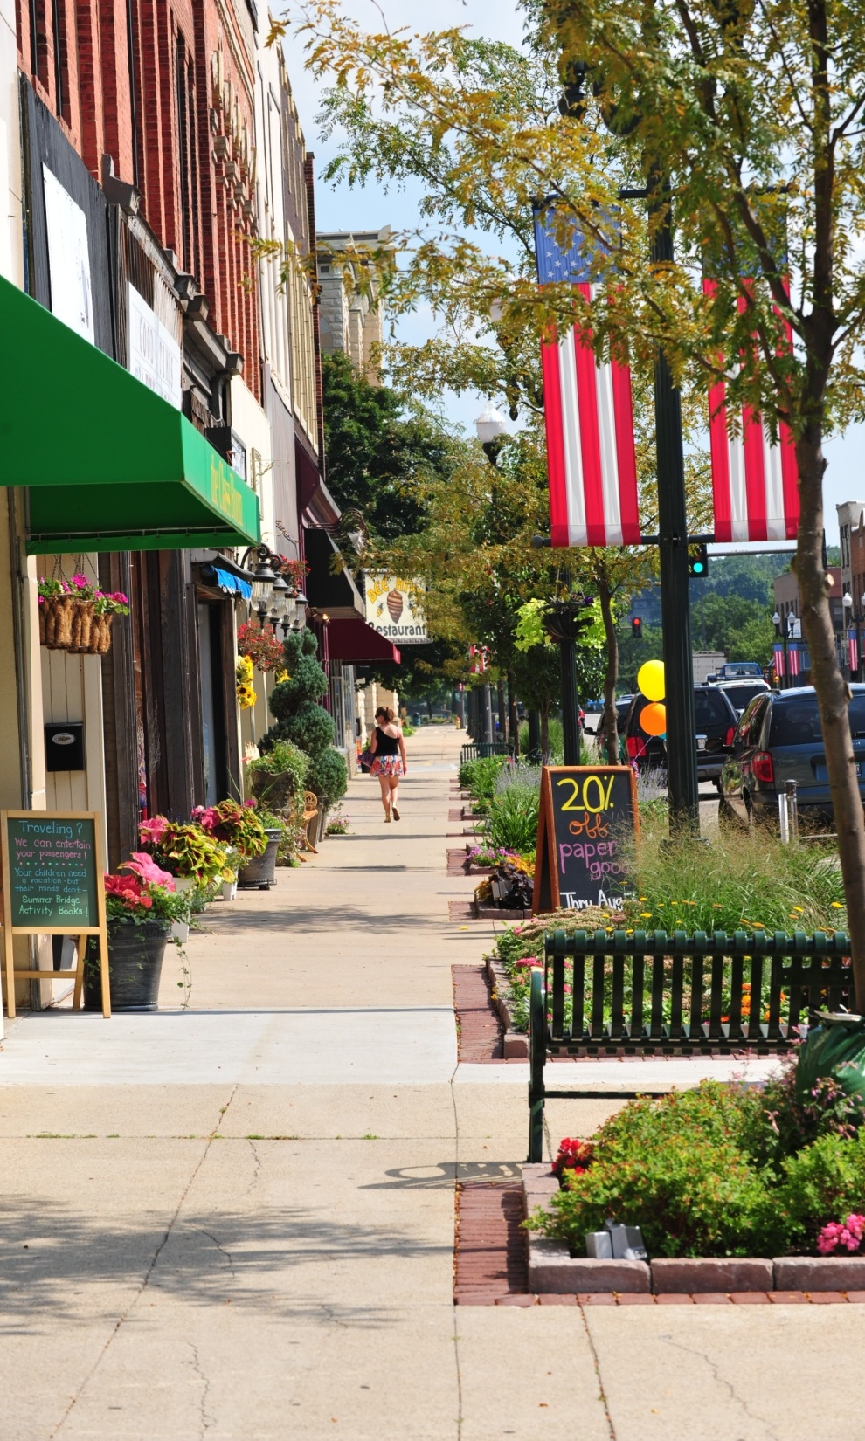
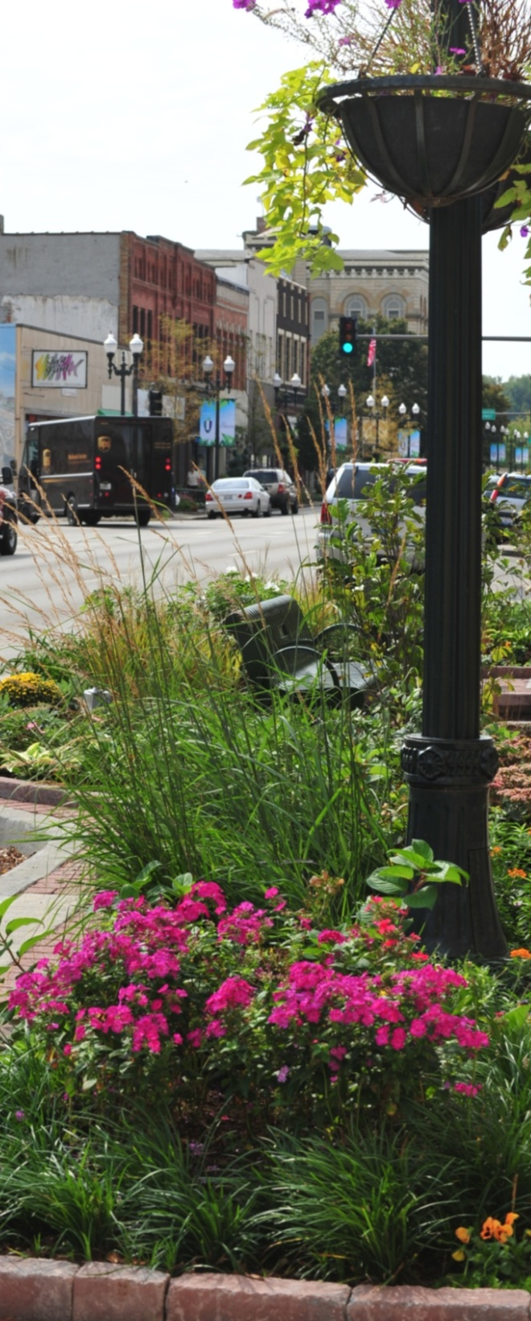
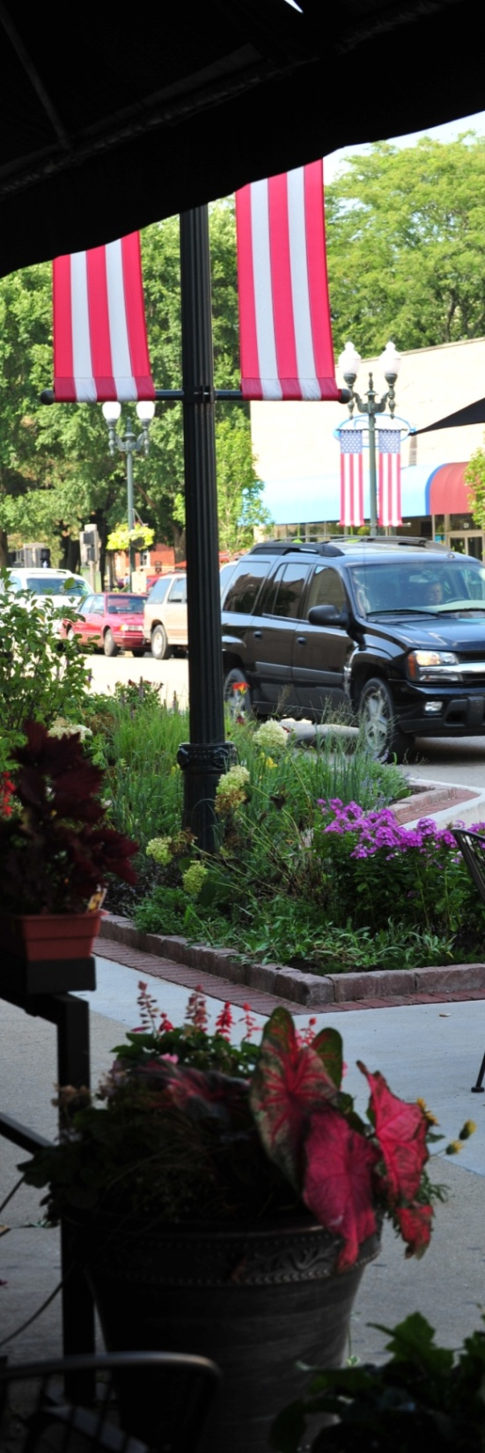

Slide 42
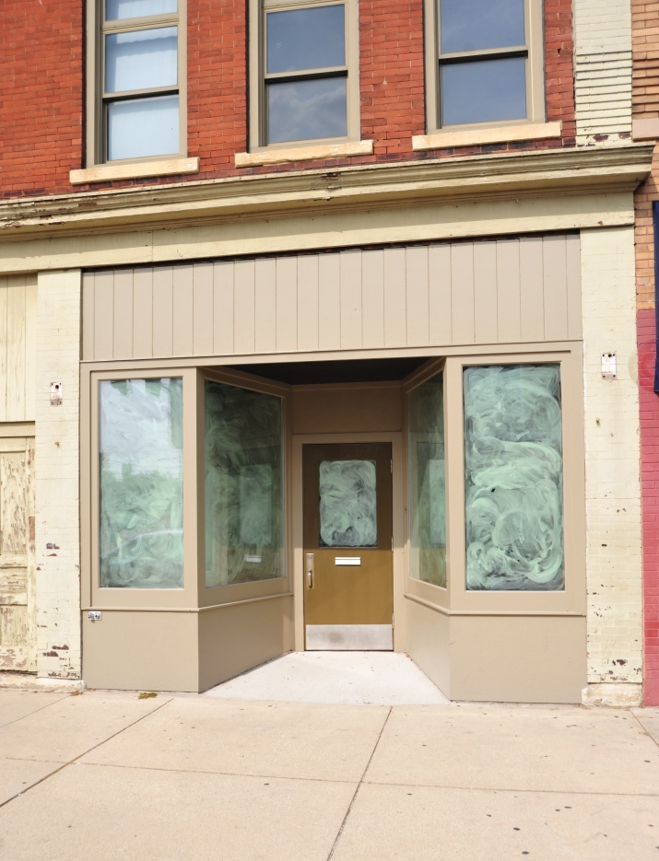
didoughs

Slide 43
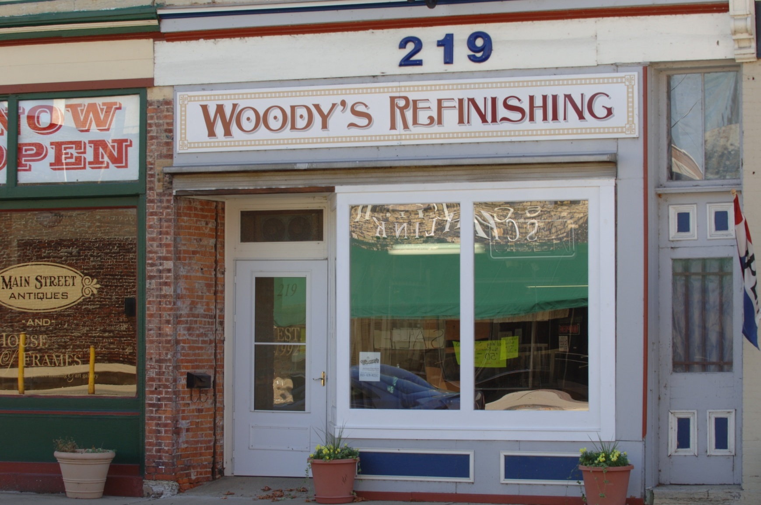
Woody’s Refinishing and Restoration

Slide 44
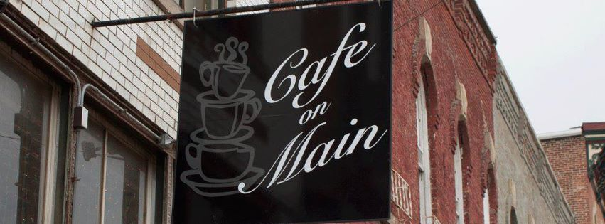
Café on Main

Slide 45
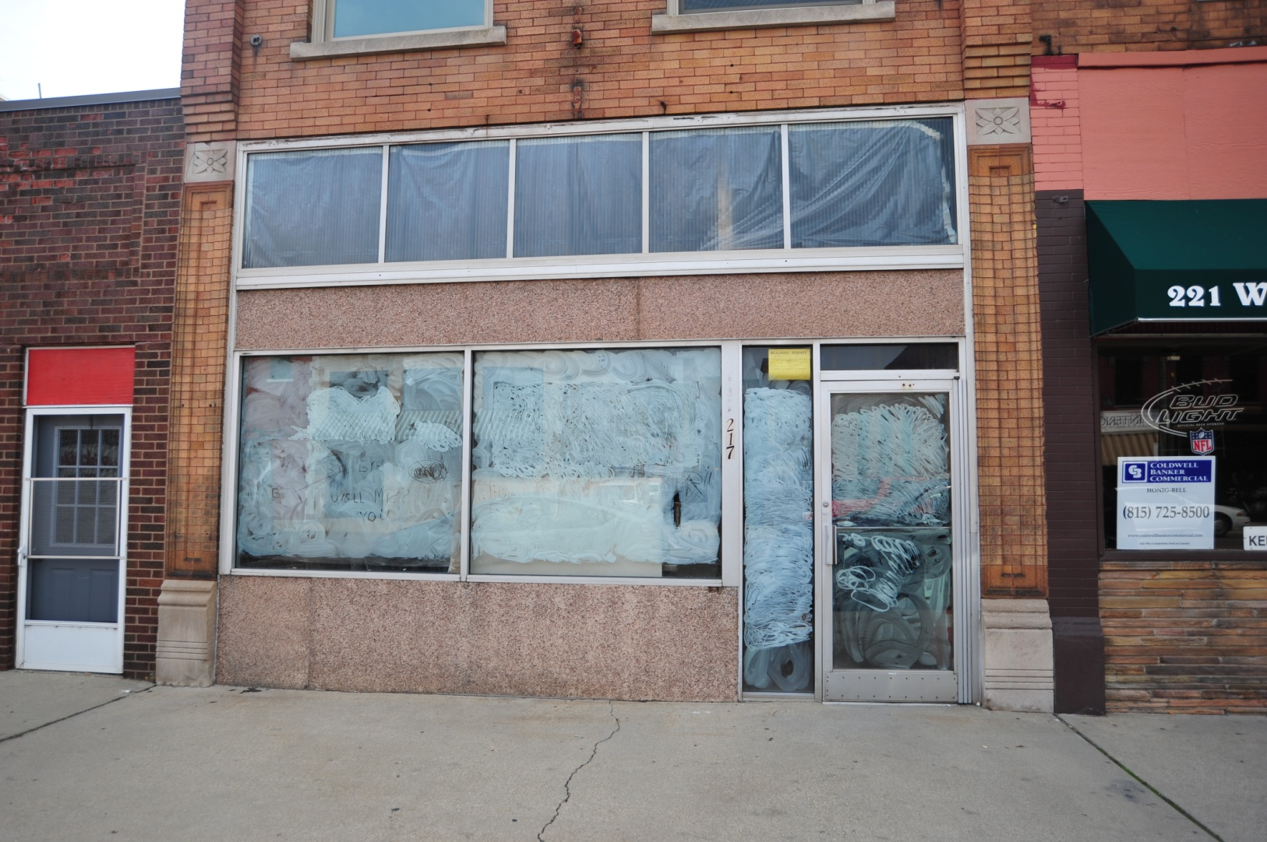
Computer Spa

Slide 46
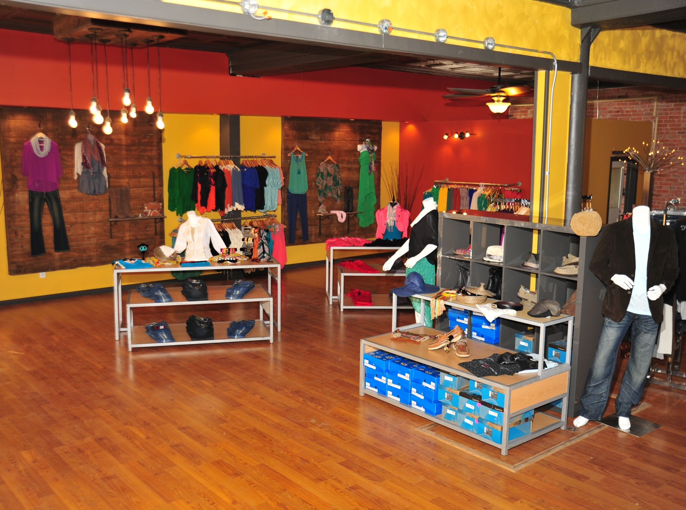
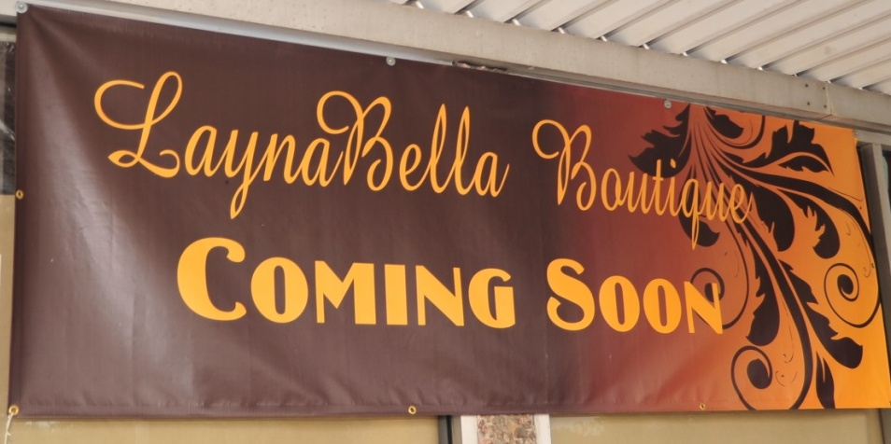

Slide 47
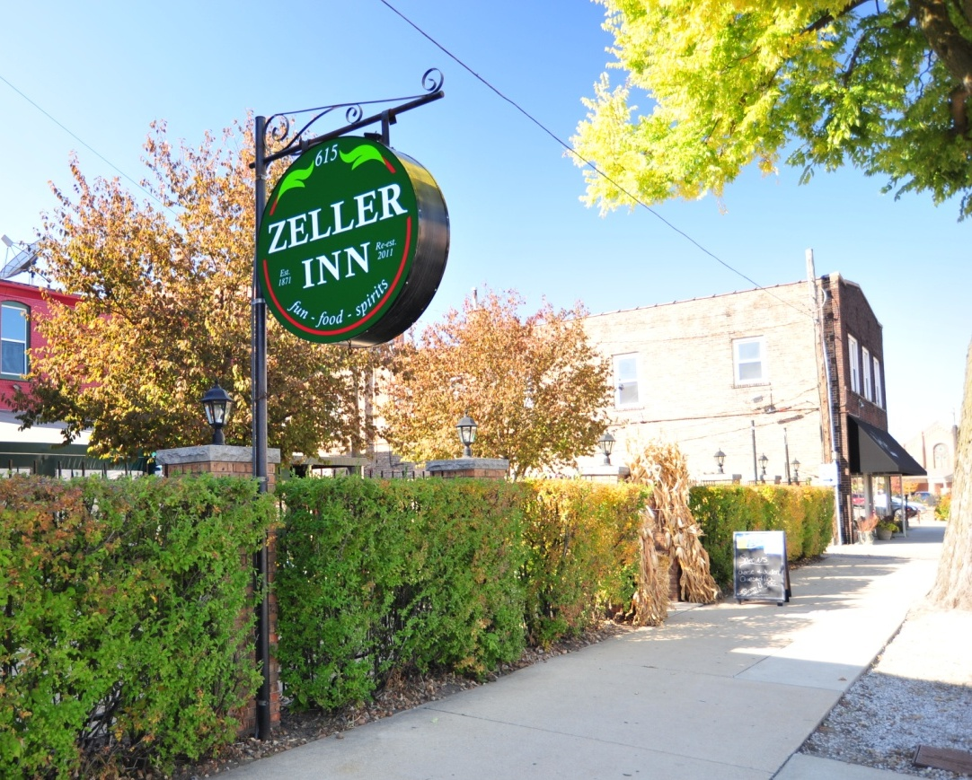
Zeller Inn

Slide 48
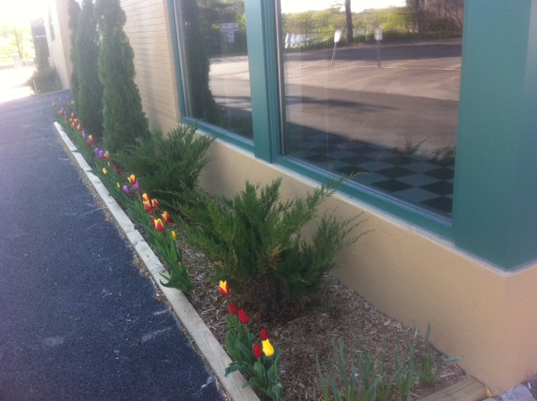
Paglis Building on Columbus Street

Slide 49
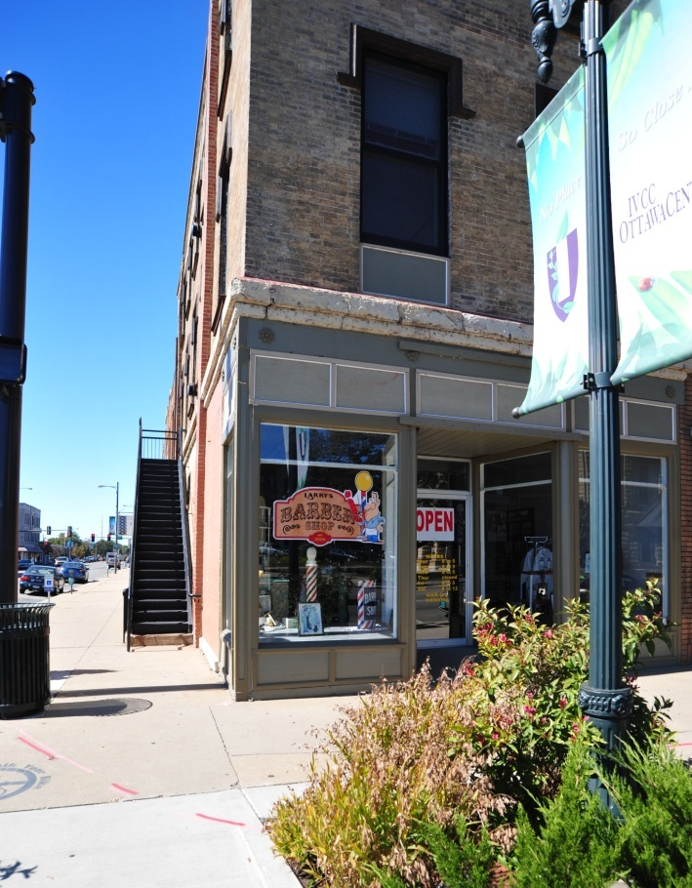
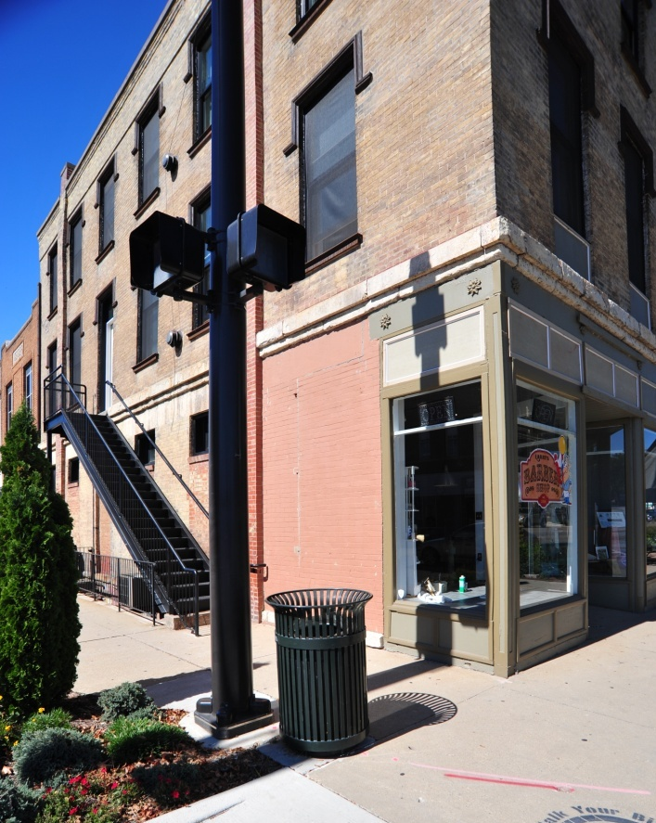
Larry’s Barber Shop – 601 LaSalle St.

Slide 50
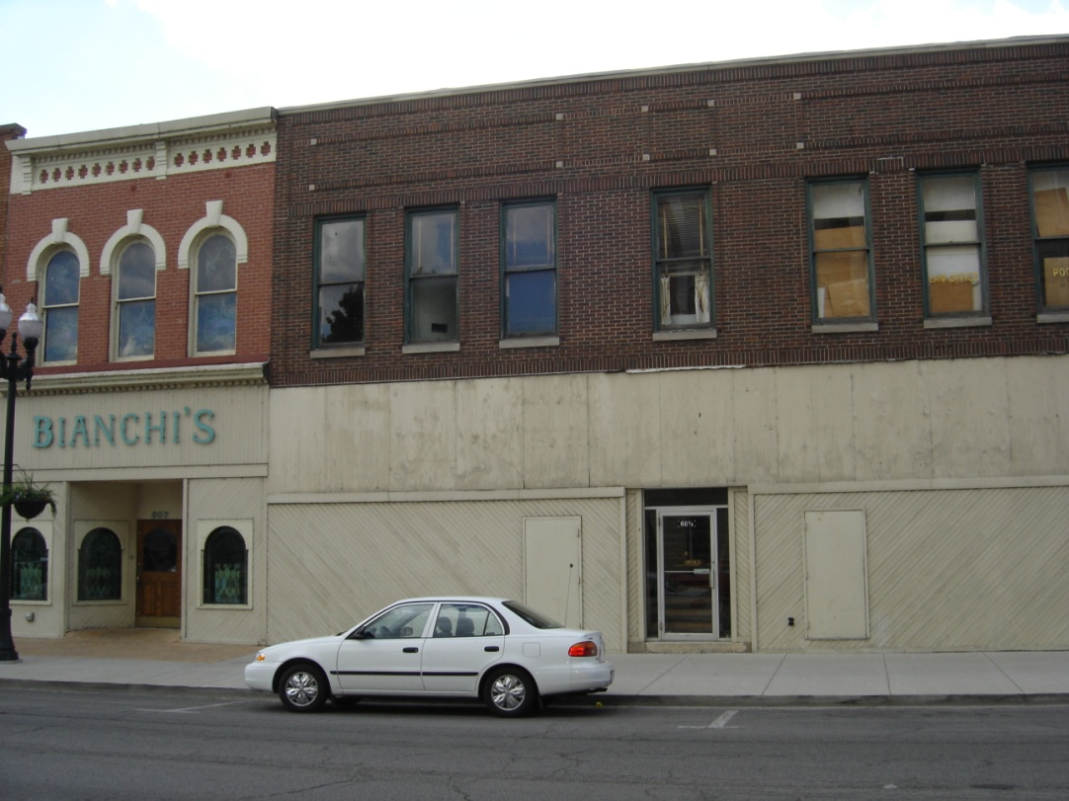

Bianchi’s Pizza
BEFORE
AFTER

Slide 51

Blue Beaker

Slide 52

Designed
For
You

Slide 53

Chic Boutique

Slide 54




Slide 55


IV Cellular
BEFORE
AFTER

Slide 56

Aussem
Dogs

Slide 57

Ramza Insurance

Slide 58


Slide 59
DOWNTOWN FESTIVALS

Slide 60

Morel Fest

Slide 61

Ottawa Two Rivers Wine and Jazz Festival

Slide 62



Ottawa Two Rivers
Wine and Jazz
Festival

Slide 63

Ottawa Two Rivers Wine and Jazz Festival

Slide 64

Farmers’ Market

Slide 65


Riverfest

Slide 66


Scarecrow Festival & Ice Odyssey

Slide 67

Festival of Lights Parade

Slide 68

Illinois River Road
Kiosk

Slide 69

IVCC Ottawa Center

Slide 70


Reddick Mansion

Slide 71

America In Bloom

Slide 72


America In Bloom

Slide 73

America In Bloom

Slide 74
RESIDENTIAL DEVELOPMENT

Slide 75

Heritage Harbor Ottawa

Slide 76


Cottages at Heron’s Landing

Slide 77



Cottages at
Heron’s
Landing

Slide 78

Townhome

Slide 79


Single Family Homes

Slide 80

Ottawa Senior Housing

Slide 81
POLICE DEPARTMENT

Slide 82
Police Department Programs
Peer Jury
Child Abduction Response Team (CART)

Slide 83


Retirement of Chief Brian L. Zeilmann

Slide 84


Promotion of Captain Brent Roalson

Slide 85

Corporal David Hallowell
“Officer of the Year”

Slide 86

Illinois Law Enforcement Alarm System

Slide 87

P2D2

Slide 88
Fire department

Slide 89

Fire Department

Slide 90

New Ambulance

Slide 91

Training

Slide 92

Disaster Drill

Slide 93


Slide 94


Urban Search & Rescue Team

Slide 95

Fire Prevention and Education

Slide 96

Safety House

Slide 97

Preemption Devices

Slide 98
Wastewater treatment

Slide 99

Monitor Flows

Slide 100

Smoke Testing

Slide 101

Combined Sewer Overflow

Slide 102

Continue Evaluations and
Maintenance

Slide 103
Water projects

Slide 104

Adams Street Watermain Project

Slide 105

New Water Billing Forms

Slide 106

Standpipe on
State Street

Slide 107
STREETS

Slide 108

North 32nd Road

Slide 109

Adams Street

Slide 110
Street Funding
General
$400,000
MFT
$500,000
Federal
$470,000
TIF
$480,000

Slide 111

Salt Storage Shed

Slide 112
Parks,
Playgrounds and recreation

Slide 113


Slide 114


Riordan Pool – Water Slide Removal
NO SLIDE
SLIDE

Slide 115

All City Swim Meet

Slide 116



Lincoln Douglas Park

Slide 117

Tennis Courts

Slide 118

New Baseball/Soccer Field

Slide 119


Bicycle Plan

Slide 120


Slide 121




Activities

Slide 122


Adult Recreation
Dance Lessons
Sunrise Yoga
Harvest Dance

Slide 123



Slide 124

OTTAWA Visitors Center

Slide 125

Ottawa Visitors Center

Slide 126

Walt Willey

Slide 127
Special Events

Slide 128

Special Events Committee
Cruise Night
Music in the Park
Founders Day Picnic
Scarecrow Festival

Slide 129


Ice Odyssey

Slide 130


Festival of Lights

Slide 131
Eastside Historic District

Slide 132


Eastside Historic Homes

Slide 133
City FINANCES

Slide 134
TOTAL BUDGET
$35 MILLION
GENERAL CORPORATE
$13.6 MILLION

Slide 135


Payroll

Slide 136


Refinancing
Savings of $860,000 over
the life of the bonds

Slide 137


Healthcare Insurance
January 2013 –
Premium Equivalents will increase

Slide 138
GRANTS

Slide 139

Central School Building
$ 2 Million

Slide 140

Central School Site

Slide 141

December 6, 1982 – flooding in the flats

Slide 142

Fox River/Flats Buy-out $914,000

Slide 143
Ottawa Industrial Park $2 Million

Slide 144
USEPA Brownfield Assessment Grants
$400,000 grant
IVCC Ottawa Center
Jordan Block
Advance Asphalt/Public Works Site
Future Hollywood Park
Peltier Glass

Slide 145
LaSalle County Transportation
$ 1 Million

Slide 146
Energy Conservation - $8,250
improve energy efficiency for lighting and HVAC systems in City Hall and Fire/Police Station

Slide 147

Emerald Ash Borer Management Plan
$12,500

Slide 148


Illinois Valley Commuter Rail
$395,000 Comprehensive Transportation Study

Slide 149

Tennis Courts
$82,000 FEMA
$20,000 U.S. Tennis Association

Slide 150
Historic Preservation
$101,000 Energy Conservation
$6,300 East Side National Register

Slide 151
Illinois Clean Energy Foundation
Additional $3,350 in grant funds

Slide 152
GRANTS
Central School Buy-Out $2,000,000
Fox River/Flats Buy-Out $ 914,000
EDA Grant for OIP Unit 2 $2,000,000
USEPA Brownfield Assessment $ 400,000
Public Transportation $1,000,000
Energy Conservation $ 8,250
Emerald Ash Borer $ 12,500
Illinois Valley Commuter Rail $ 395,000
Tennis Courts $ 102,000
Historic Preservation $ 107,000
Illinois Clean Energy $ 3,350
TOTAL $ 6,942,100

Slide 153
volunteers

Slide 154

Volunteers

Slide 155

Volunteers

Slide 156
CONCLUSION

Slide 157
Special Thank You
to
Mark Pentecost for Photos

